Slide 1
ELSEWeb meets SADI

Slide 2
Outline
Understanding ELSEWeb and the Model Web
Enabling Discovery through ontologies
Enabling Transformation through SADI
Service Orchestration through SHARE
Modeling and the Chihuahuan Desert in ELSEWeb
Making sense of results through provenance

Slide 3
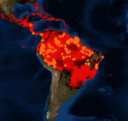
A Common Pattern of the Model Web
“…a system of interoperable computer models and databases communicating primarily via web services” – Geller 2009
Modeling Environment (WCS)
Web Client
Modeling Service (WPS)
Species Data
Data and Models exposed as services

Slide 4
Potential Limitations of the Model Web
- Where can I find relevant data?
- How do I know it is relevant?
Discovery Limitations
What transformations are required to satisfy requirements?
Web Client
Modeling Service (WPS)
Interface Requirement Disparities

Slide 5

Earth, Life, and Semantic Web
The goal of ELSEWeb is to streamline the flow of heterogeneous geographic, social, and geological data into Lifemapper modeling services
EDAC WCS Data
Semantic Metadata
Adapter KB
Orchestration Agent
Web Client
Lifemapper
(RESTFull)
Lifemapper Species Data
ELSEWeb Semantic Mediation Layer

Slide 6
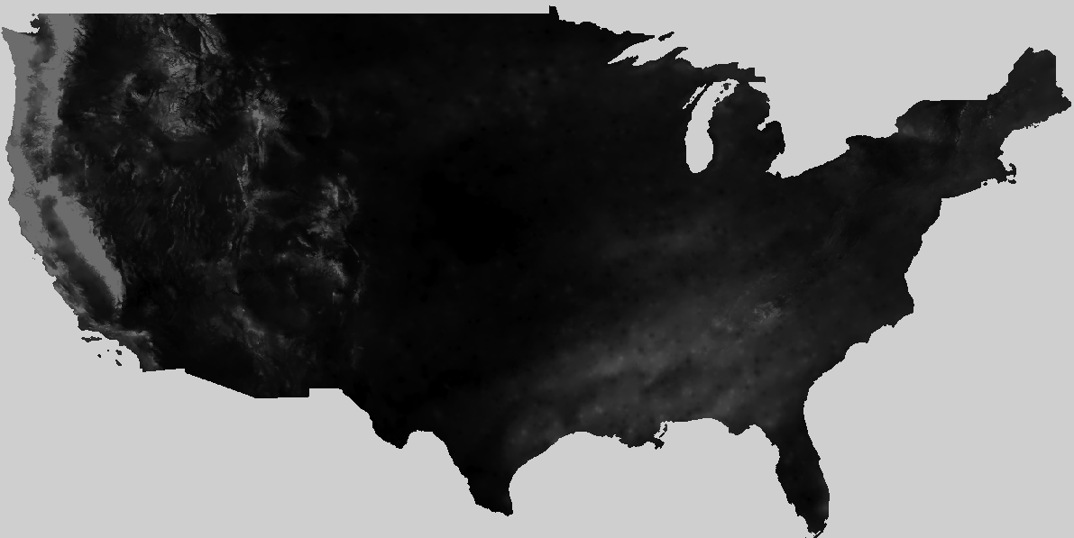
ELSEWeb Components
Metadata
OWL
Metadata
Individuals
EDAC Data
ELSEWeb Data
Selector Service
cardioSHARE coordinates execution of services to satisfy a query
ELSEWeb Adaptor Services
Adaptor Service 1
cardioSHARE + Pellet
Adaptor Service n
SADI Service OWL
Experiment Specifications RDF
Model Generation Query (SPARQL)
Lifemapper Service

Slide 7
Earth Data Analysis Center
CF Keywords
GCMD
Categories
WCS Get Capabilities
XML
FGDC XML
ISO
19115
Topic
Categories
Metadata Store
Harvest: translate metadata descriptions into our ELSEWeb data model
ELSEWeb Data
Data Store
WCS Data = Multipart MIME = Payload Tiff + Metadata

Slide 8
Desirable Data Model
What kind of data?
OBOE: Observation Ontology
Where can I get the data?
DCAT: Data Catalog Vocabulary
How was the data generated?
Who was responsible for publishing?
When was it generated?
PROV-O: Provenance Ontology

Slide 9
EDAC Semantic Data Model
dcat:dataset
dcat:distribution
Catalog
Dataset
Distribution
rdfs:subClassOf
dc:temporal
dc:spatial
PeriodOfTime
WCSCoverage
Location
oboe:ofCharacteristic
oboe:measurementFor
Characteristic
Measurement
Observation
DCAT
rdfs:subClassOf
oboe:ofEntity
OBOE
Activity
Entity
PROVO

Slide 10
Mapping CF to OBOE
CF vocabulary couples entities with measurements, so we need to decompose:
dew_point_temperature
Entity
Characteristic
Prepackaged with
OBOE.owl
Atmospheric Feature
Temperature
DewPoint
Need to reuse other ontologies such as SWEET to extend OBOE
An ELSEWeb extension

Slide 11
Describing Adaptors using SADI
Adaptor services perform operations such as:
Data selection – binds specifications to satisfactory data
Data transformations – transform structure or format of data
Modeling – implement modeling algorithm
Adaptor services are implemented as Semantic Automated Discovery and Integration Services:
outputParameter
ServiceDescription
Operation
Parameter
hasOperation
inputParameter
ELSEWeb Adaptor Services

Slide 12
An Example SADI Service: Extractor
Distribution
rdfs:subClassOf
elseweb:hasWCSCoverageDistribution 1..10
WCSCoverage
Distribution
WCSScenario
myGrid:inputParameter
rdfs:subClassOf
rdfs:subClassOf
SADI OWL
WCSPayloadExtractor
ELSEWeb OWL
myGrid:outputParameter
TiffExtracted
WCSScenario
Elseweb:hasExtractedTiffScenario
WCSPayload
12

Slide 13
Coordinating Adaptor Execution
The carioSHARE agent constructs a knowledge base that supports the answering of an input SPARQL query
The cardioSHARE client gather triples either inferred from Pellet or returned from a SADI service:
ELSEWeb Adaptor Services
select ?experiment ?modelURL
from <http://ontology.cybershare.utep.edu/experiment-1.owl>
where
{
?scenario a scenario:SatisfiedScenarioRequirements.
?scenario scenario:hasSatisfactoryWCSScenario ?wcsScenario.
?wcsScenario a scenario:TiffExtractedWCSScenario.
?wcsScenario scenario:hasExtractedTiffScenario ?tiffScenario.
?experiment lifemapper:hasLifemapperScenario ?tiffScenario.
?experiment lifemapper:hasModel ?model.
?model lifemapper:hasModelURL ?modelURL.
?experiment a lifemapper:CompletedExperiment.
}
cardioSHARE
Experiment Specifications RDF
Model Generation Query (SPARQL)
Referenced via FROM clause

Slide 14
The Experiment Specification
ExperimentSpecification
ModelingAlgorithm
WCSScenario
Requirements
OccurrenceSet
Data
Parameter
Class: ExecutableExperiment
EquivalentTo:
(hasLifemapperScenario some LifemapperScenario)
and (hasModelingAlgorithm some ModelingAlgorithm)
and (hasOccurrenceSetID some rdfs:Literal)
and (hasScenarioLayerUnits some rdfs:Literal)
cardioSHARE executes sequence of services that support this tranformation
TiffScenario =
LifemapperScenario
ExecutableExperiment
Lifemapper SADI services ingests ExecutableExperiments

Slide 15
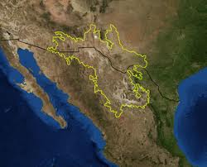
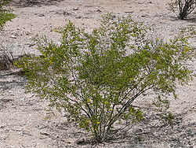
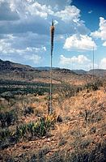
Use Case: Chihuahuan Desert Encroachment
Region: Northern Mexico, West Texas and Southern New Mexico
Terrain: Basins and Mountain Ranges
Climate: Mild Summer (35 – 40° C)
Flora:
Larrea Tridentata
Observation: Over the past 100 years, the Chihuahuan desert has encroached on existing grasslands, resulting in altered erosion patterns and thus an altered landscape.
Agave lechuguilla
Notes:
More informative title!!!! For example: the semantics of the scientific question

Slide 16
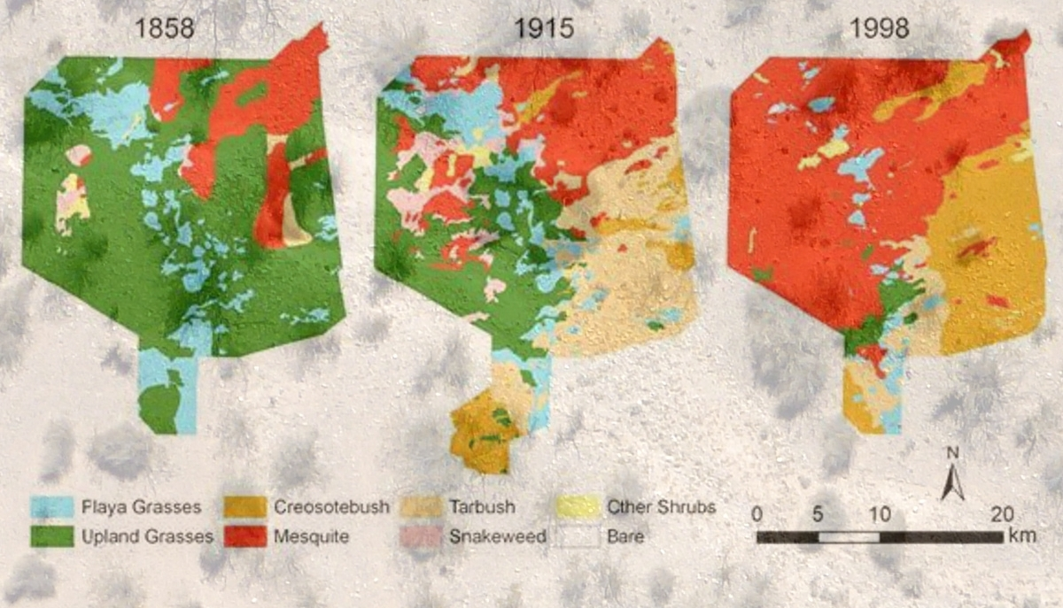
Transition from Grassland to Desert

Slide 17
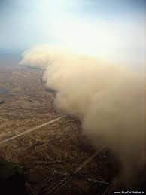
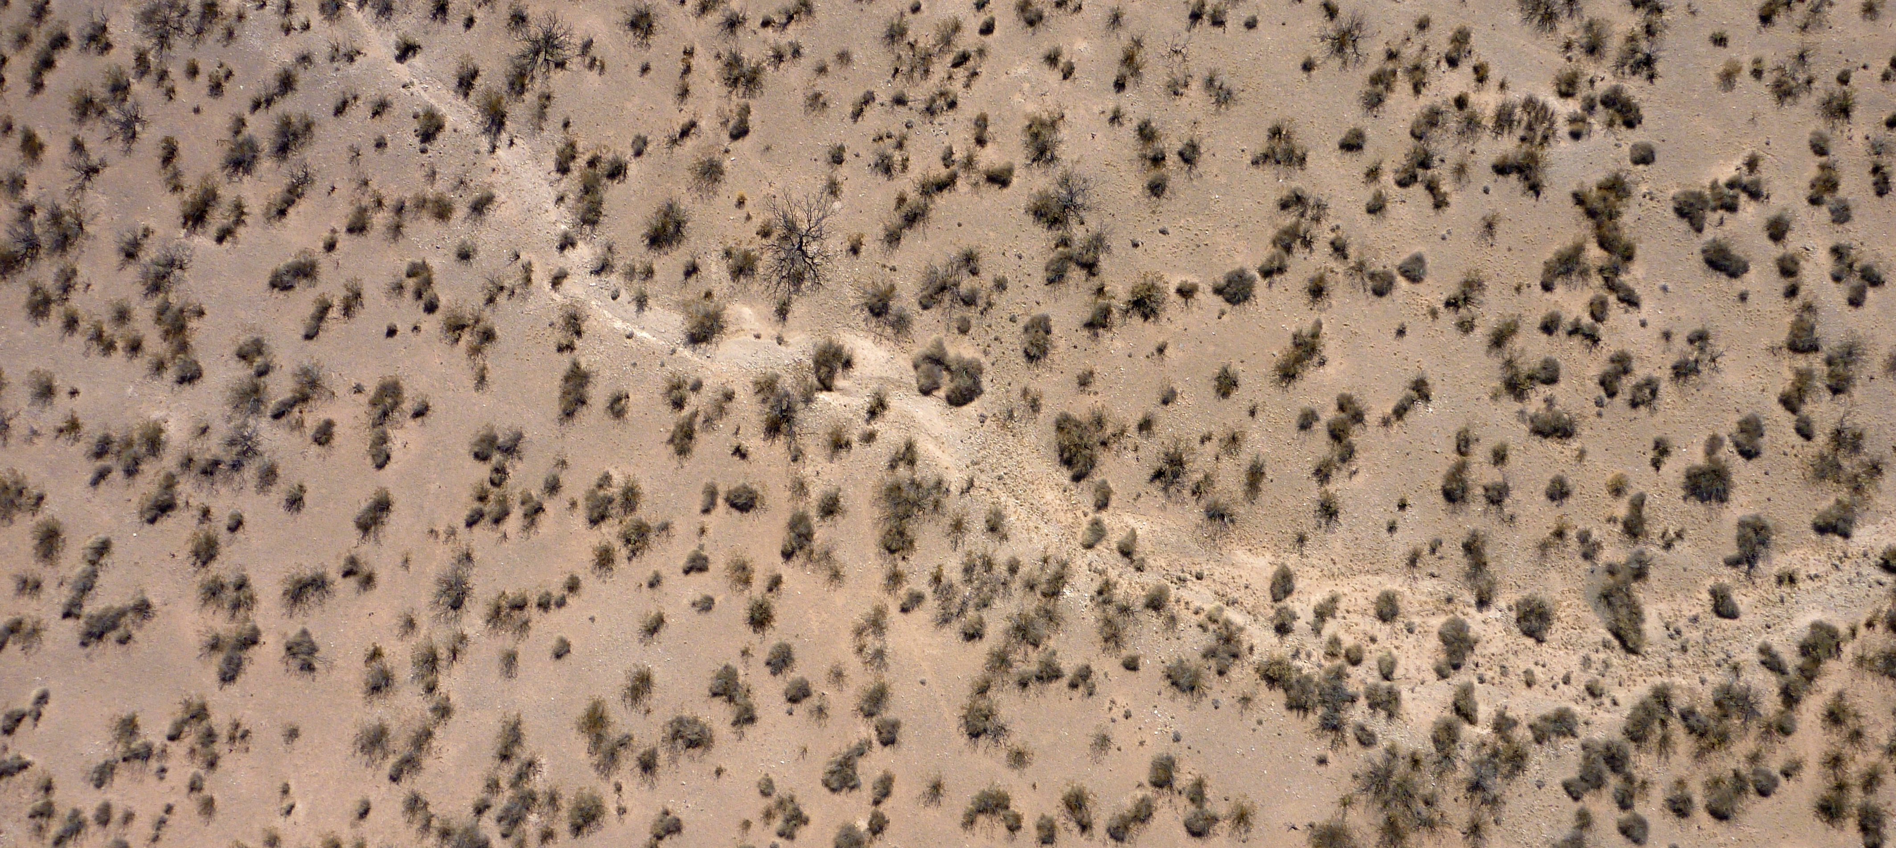
Implications of an Encroaching Desert Ecosystem
Sparse vegetation of the Chihuahuan desert
Dust storms containing allergens such as fungus
Sparse vegetation of mesquite shrubs leads to altered erosion patterns, creating an environment suitable for dust storms.
Notes:
Get high resolution pics from Fransca from viz wall. Get them from Frank ☺ Possible video, test to see if works. Be sure to give credit

Slide 18
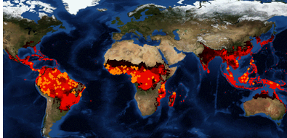

Species Distribution Modeling
Predictions: If we move to hotter climates with more variable precipitation, will we get further encroachment in the desert?
Will we get more erosion?
Will we get higher flood events?
Species Distribution Models (SDM) can provide insight:
“I want to model the transition from grassland to Chihuahuan desert during historic regions of drought”
Notes:
List all people at teams: lifemapper, edac, and UTEP. Include all people even non-authors. Introduce in the beginning with logos and picture of peoples.

Slide 19
Ultimate ELSEWeb Goal
2
Denotes a duration of time encompassing a set of relevant environmental data
Data discovery, integration, transformation
1
These biomes are not defined solely by geographic coordinates; they are partially defined by its migrating flora (interpretation)
3
“I want to model the transition from grass lands to Chihuahuan desert (probably steppe), during historic periods of drought”
4
Drought denotes an event, that contextualizes a set of geospatial data within some space/time (interpretation)
We want to support these kinds of queries, but currently can only support 1.
Notes:
Identify the current and future work, perhaps by highlights. This is a work in progress, but we have some initial results for (1). This is achalleng that evolves but we are addressing the particular grant with was targeted with 1.

Slide 20
A Chihuahuan Desert Experiment Specification
The environment scenario consists of five layers
Individual: <http://ontology.cybershare.utep.edu/ELSEWeb/experiments/experiment-1.owl#wcsScenarioRequirements>
Types:
scenario:WCSScenarioRequirements
Facts:
scenario:hasWCSDistributionRequirement2 <experiment-1.owl#distributionRequirement2>,
scenario:hasWCSDistributionRequirement4 <experiment-1.owl#distributionRequirement4>,
scenario:hasWCSDistributionRequirement3 <experiment-1.owl#distributionRequirement3>,
scenario:hasWCSDistributionRequirement1 <experiment-1.owl#distributionRequirement1>,
scenario:hasWCSDistributionRequirement5 <experiment-1.owl#distributionRequirement5>
Layer 3 should be bound to Surface Temperature within some space/time frame
Individual: <experiment-1.owl#distributionRequirement3>
Types:
scenario:WCSDistributionRequirement
Facts:
terms:spatial <experiment-1.owl#region1>,
scenario:hasEntityClass elsewebdata:SurfaceLayer,
scenario:hasCharacteristicClass <oboe-characteristics.owl#Temperature>,
terms:temporal <experiment-1.owl#duration3>

Slide 21
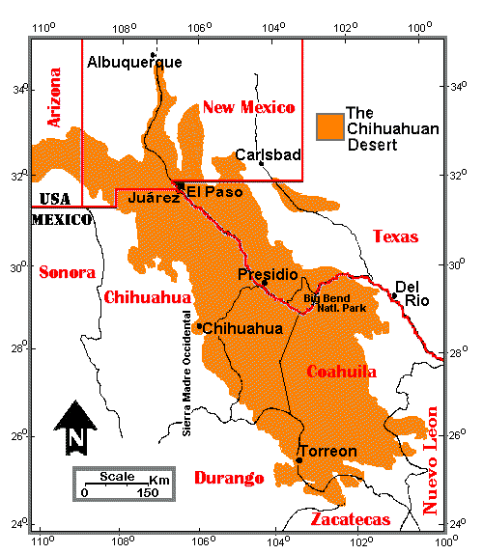
A Chihuahuan Desert Experiment Specification
Space and Time Constraints
Individual: <experiment-1.owl#region1>
Types:
elsewebdata:Region
Facts:
elsewebdata:hasUpperLatitude 35.0,
elsewebdata:hasRightLongitude -95.0,
elsewebdata:hasLowerLatitude 25.0,
elsewebdata:hasLeftLongitude -110.0
Individual: <experiment-1.owl#duration3>
Types:
elsewebdata:Duration
Facts:
elsewebdata:hasEndDate "0200-12-31T00:00:00-07:00"^^xsd:dateTime,
elsewebdata:hasStartDate "0201-02-28T00:00:00-07:00"^^xsd:dateTime

Slide 22
ELSEWeb and Prov-o
Each SADI service is configured to capture the input and output RDF as uniquely identified named graphs
<rdf:Description rdf:about=“namedGraph_1384383646553.rdf">
<j.3:wasGeneratedBy>
<j.4:prov-sadi.owlSadiService rdf:about="http://elseweb.cybershare.utep.edu/WCSCoverageRequirementsService">
<j.3:used>namedGraph_1384383646232.rdf</j.3:used>
</j.4:prov-sadi.owlSadiService>
</j.3:wasGeneratedBy>
</rdf:Description>

Slide 23
Provenance Visualization

